Slide 1
Открытый урок по английскому языку
4 класс
Исламова Миляуша Шаеховна
Казань 2017 г. Гимназия № 17

Slide 2
Hello! My name is Bravy. I live in the forest with my friends. They are bears, foxes, wolves, ants, snakes and others. I’m faster than a snail, but I’m slower than a cheetah. I’m shorter than a giraffe, but I’m taller than a tortoise. I have got the longest ears and the shortest tail. I have got the funniest mouth and the nicest eyes. I like to play with my friends. (questions)

Slide 3
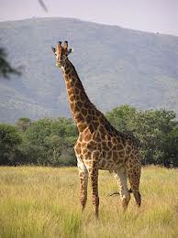
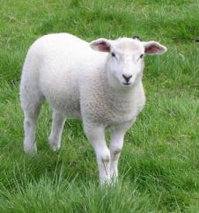
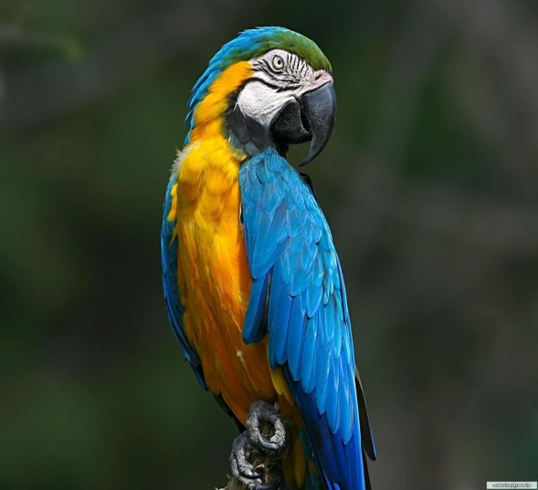
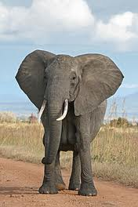
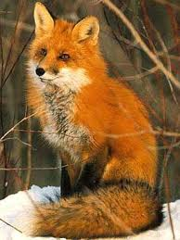
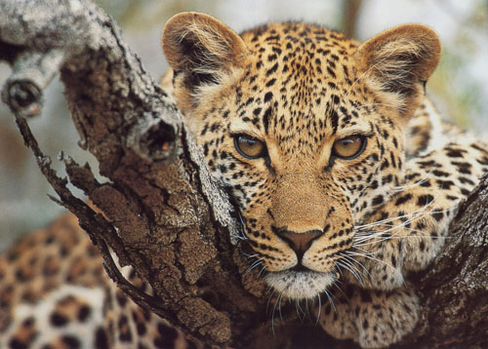

Slide 4
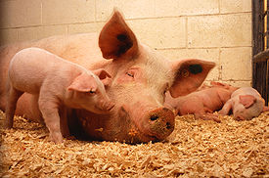
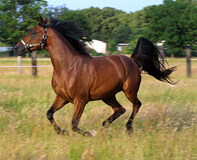
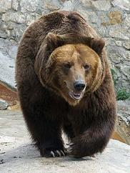
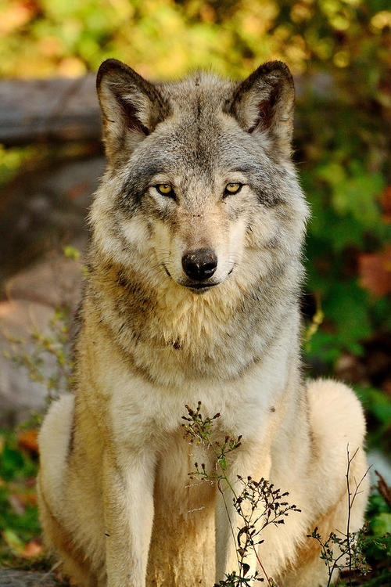
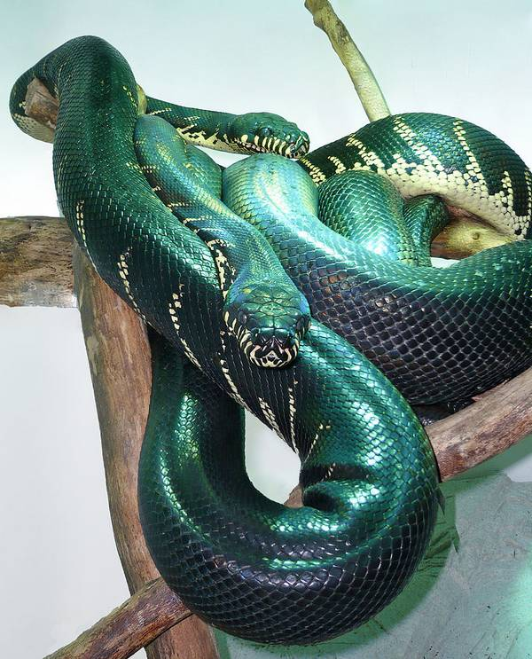
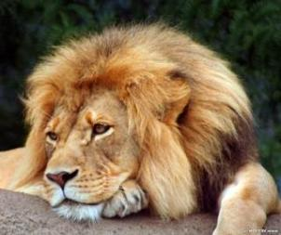

Slide 5
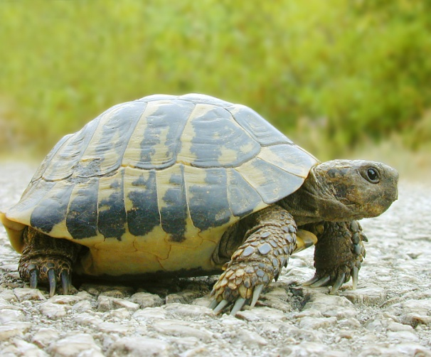
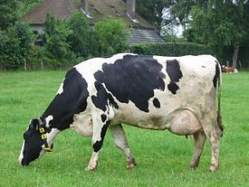
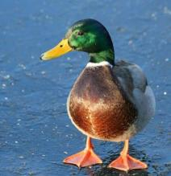
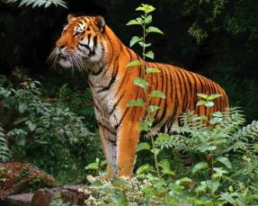
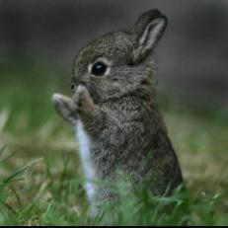
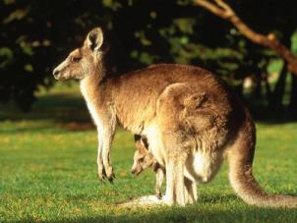

Slide 6
Let’s complete the words
whale | elephant | dolphin | crocodile | monkey
lizard | panda | hippo | giraffe | snail

Slide 7
The Animal World
We’ll know:
Where the animals live;
What they eat;
What they can do;
How to compare the animals.

Slide 8
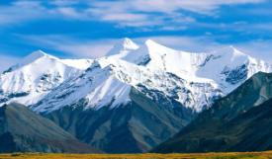
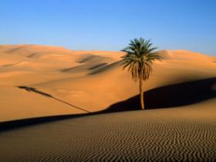
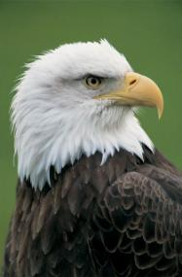
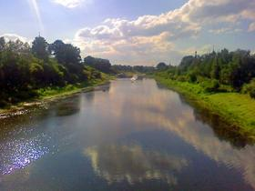
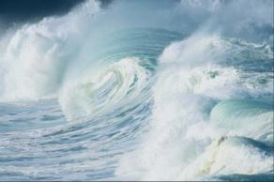
Where does an eagle live?
mountain
desert
eagle
river
ocean sea

Slide 9
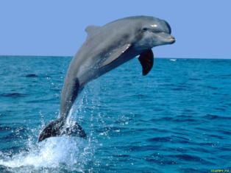
Where does a dolphin live?
mountains
desert
dolphin
river
ocean sea

Slide 10
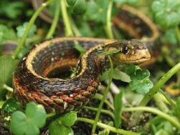
Where does a snake live?
mountains
desert
snake
river
ocean sea

Slide 11
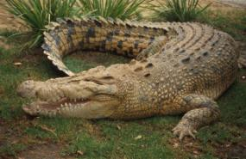
Where does a crocodile live?
mountains
desert
crocodile
river
ocean sea

Slide 12
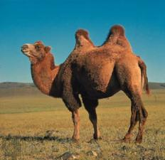
Where does a camel live?
mountains
desert
camel
river
ocean sea

Slide 13
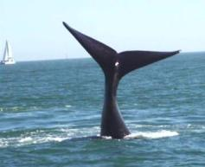
Where does a whale live?
desert
mountains
whale
river
ocean sea

Slide 14
Hello! My name is Bravy. I live in the forest with my friends. They are bears, foxes, wolves, ants, snakes, and others. I’m faster than a snail, but I’m slower than a cheetah. I’m shorter than a giraffe, but I’m taller than a tortoise. I have got the longest ears in our forest. I have got the shortest tail and the funniest mouth. I have got the nicest eyes. I like to play with my friends. (questions)

Slide 15
Put the right form
1).The dog is (smart) … the crocodile.
1). The dog is smarter than the crocodile.
2).The dolphin is (kind) … the tiger.
2).The dolphin is kinder than the tiger.
3).The mouse is (small) … the dog.
3).The mouse is smaller than the dog.
Now make up your own sentences.
Notes:
crjcjdi

Slide 16
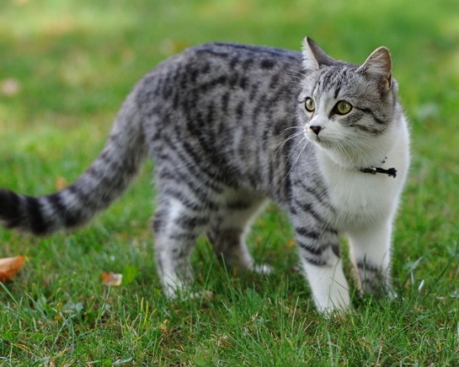
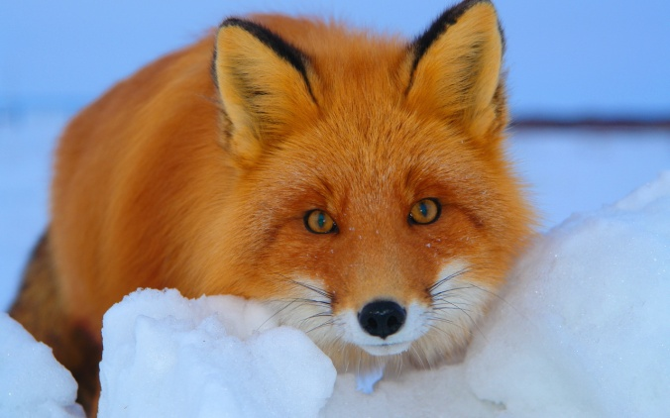
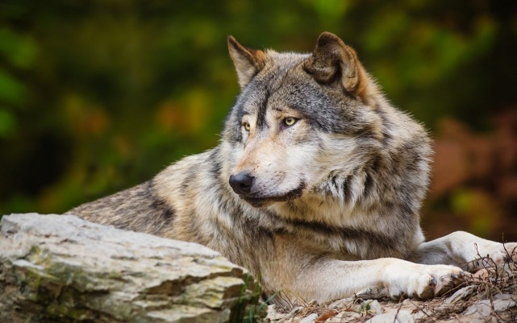
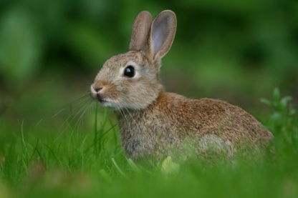
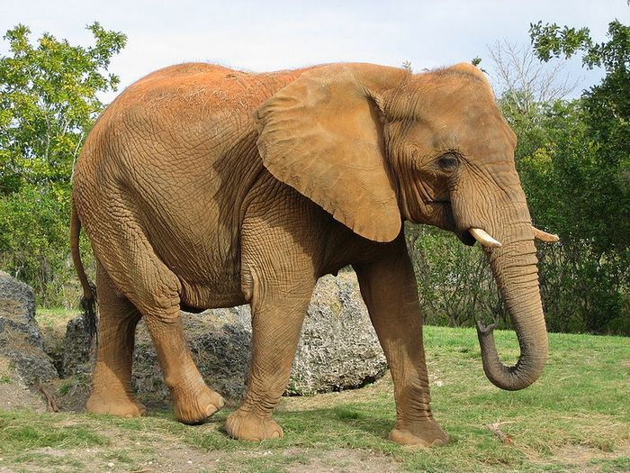
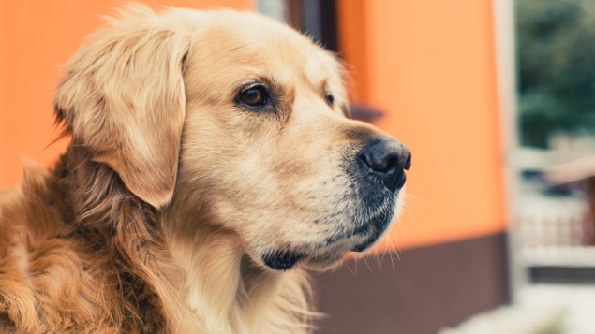
Compare these animals, using adjectives : (strong, weak, big, small, kind, fat, thin, clever.)

Slide 17
Hello! My name is Bravy. I live in the forest with my friends. They are bears, wolves, foxes, ants, snakes and others. I’m faster than a snail, but I’m slower than a cheetah. I’m shorter than a giraffe, but I’m taller than a tortoise. I have got the longest ears in our forest. I have got the shortest tail, the funniest mouth and the nicest eyes. I like to play with my friends. (questions)

Slide 18
The cheetah is the fastest in the world.
Put the right form
The snail is … (slow) of all.
The snail is the slowest of all.
The dolphin is … (kind) of all.
The dolphin is the kindest of all.
The cheetah is … (fast) in the world.
Now make up your own senteces.

Slide 19
Training
Stand up anyone who is the (tallest, strongest, cleverest, fastest, slimmest, happiest…) in your group.

Slide 20
Funny, big, nice, tall, fast, strong, fat

Slide 21
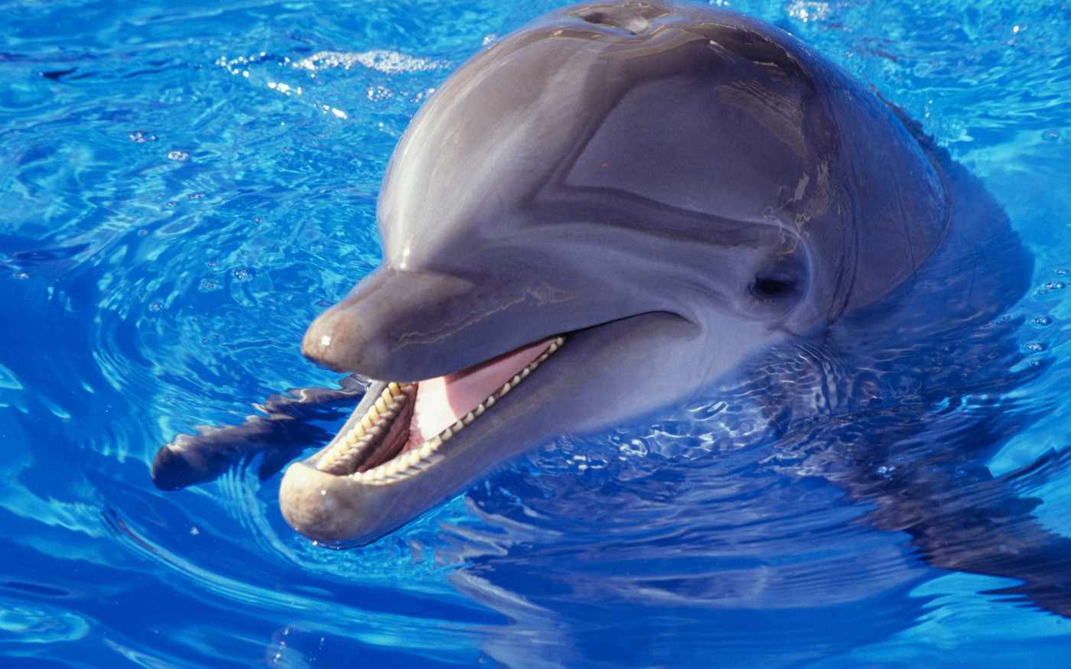
I live in the sea. I eat fish. I am the fastest swimmer. I am very kind and clever. What am I ?

Slide 22
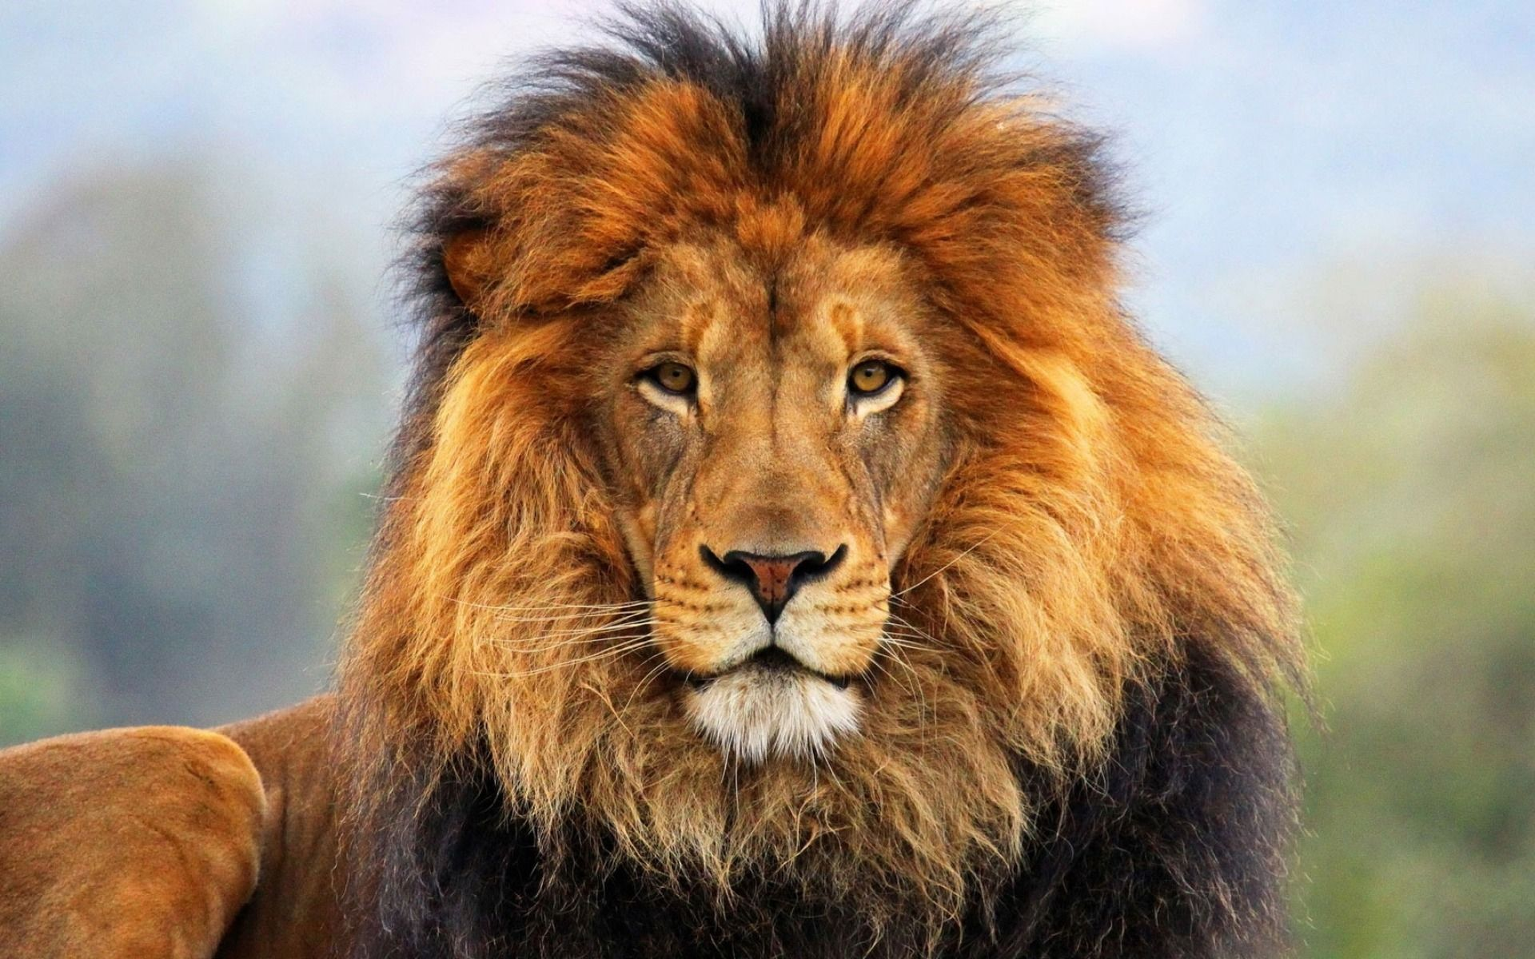
I live in the jungle. I am fast but the cheetah is faster than me. I am a king of the jungle.I eat meat.

Slide 23
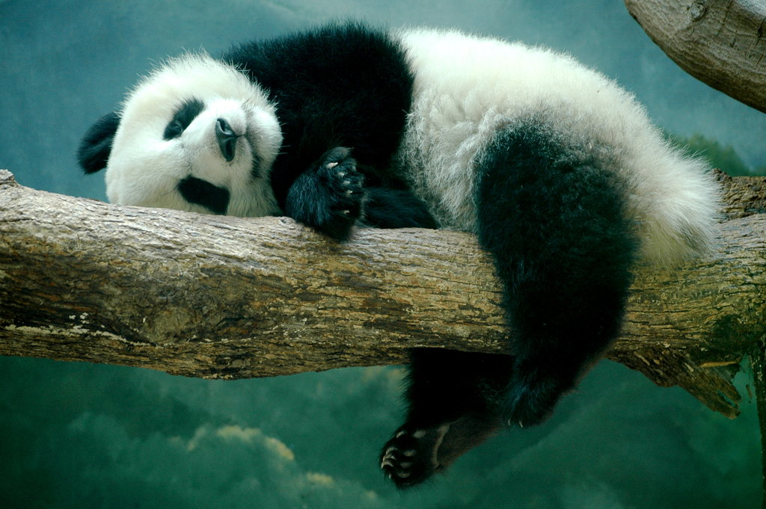
I live in the mountains in China. I can reach 150 kilos. I eat bamboo. What am I ?

Slide 24
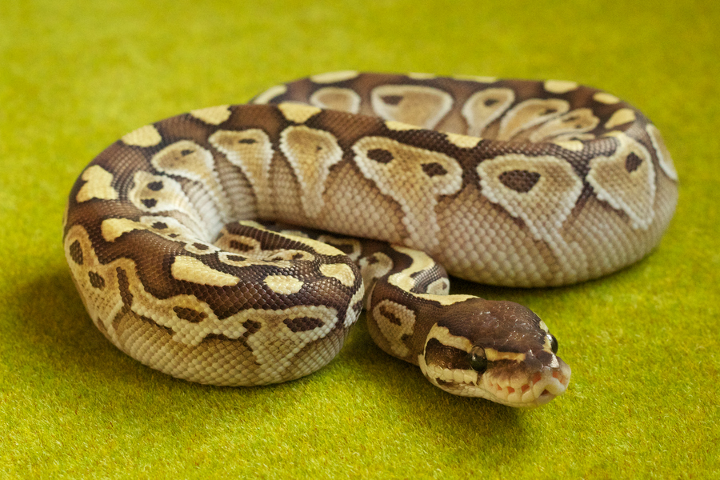
I live in the jungle. I am longer than the lizard. I have got no legs. I can eat the cow .

Slide 25
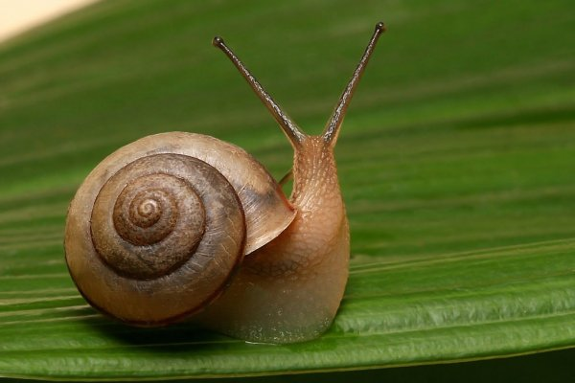
I live near the river. I am smaller than a tortoise. I eat leaves. I’m the weakest in the world. What am I ?

Slide 26
Make up your own riddles

Slide 27
What does it look like?
Choose an animal, answer the questions and say about it
What does it eat?
What can it do?
Where does it live?
мarks

Slide 28
Homework
-draw a picture of any animal;
- write down the following sentences:
what it is like;
where this animal lives;
what it eats;
what it can do.
- compare it with the other animal.

Slide 29
My progress
Now I know:
- where the animals live;
- what they eat;
- what they can do.
- how to compare the animals
Now I can say:
- where the animals live;
- what they eat;
- what they can do.
- how to compare the animals

Slide 30
My Progress
Excellent |  | !!!
Good |  | !!
Not so good |  | *

Slide 31
Homework
Выполните упражнение
№ 5 на странице 79.

Slide 33
The End

Slide 34
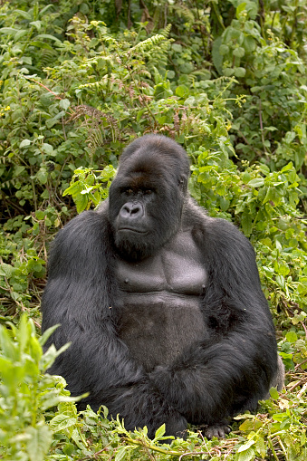
I live in the jungle. I eat fruit, plants, insects. I’m the cleverest. What am I ?

Slide 35
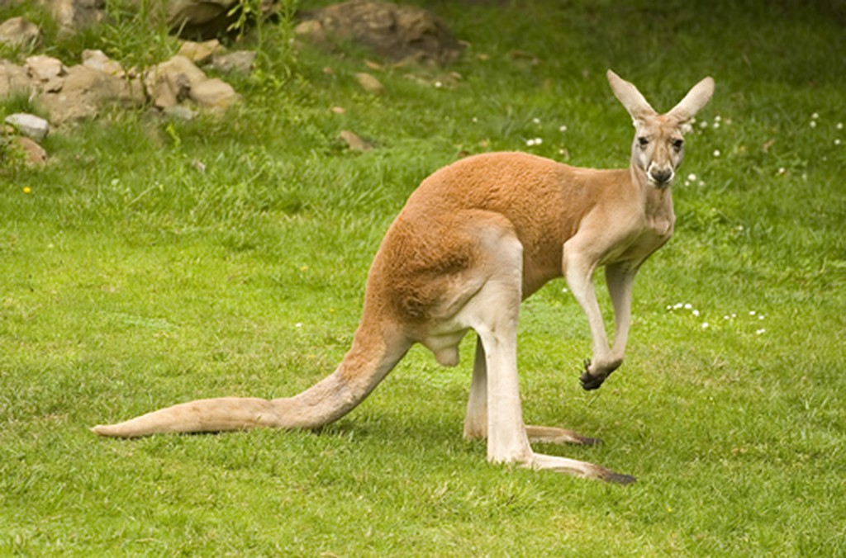
I’ve got a long tail and big feet. I am the best jumper in the world. I’ve got a bag for my child.

Slide 36
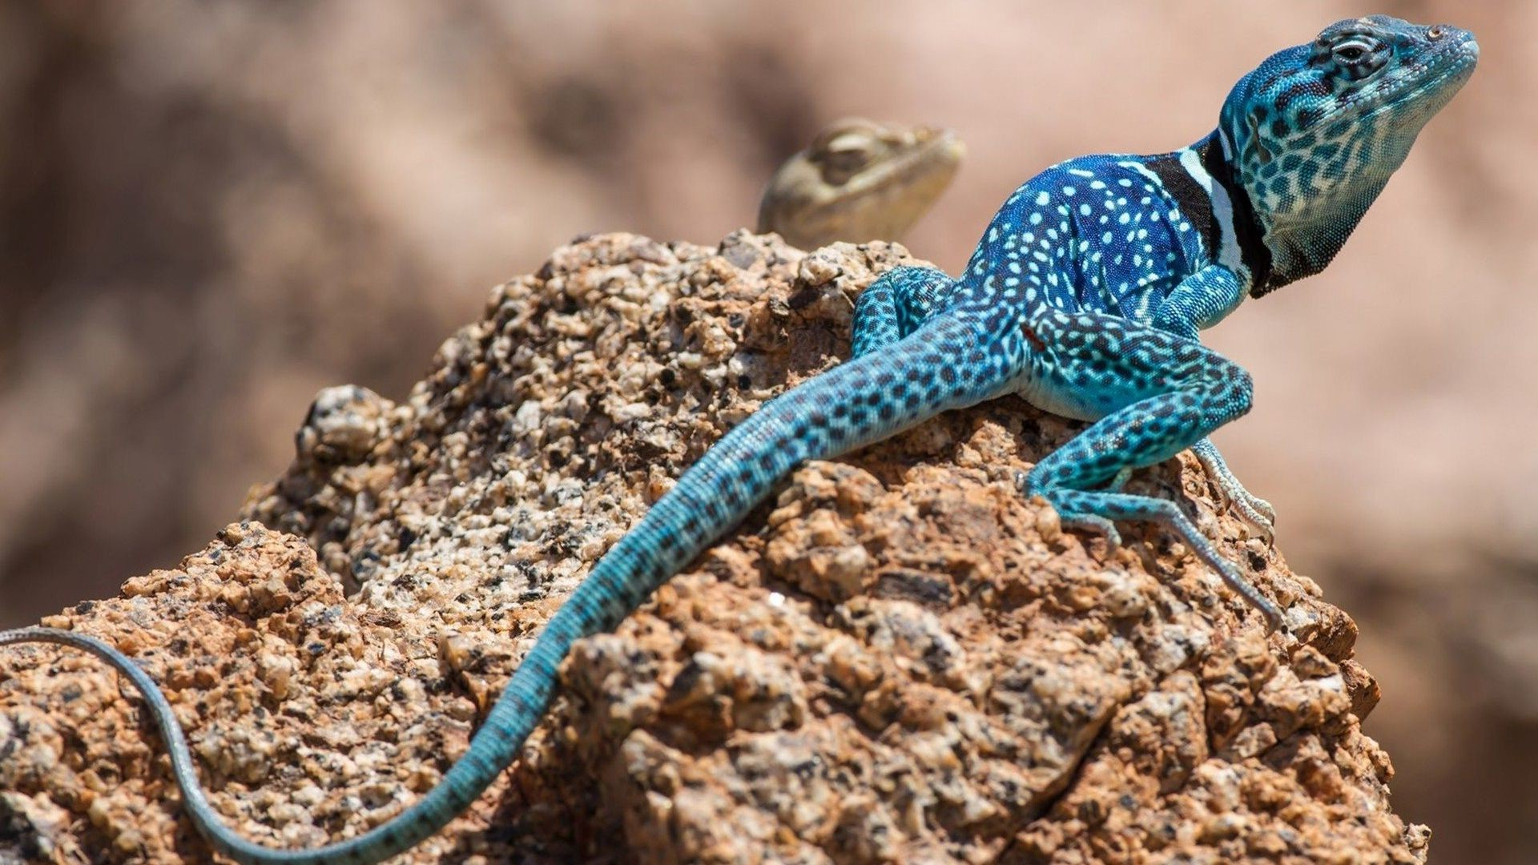
I live in the desert. I have got the longer tail than the tortoise. I can climb the mountains and sands.

Slide 38
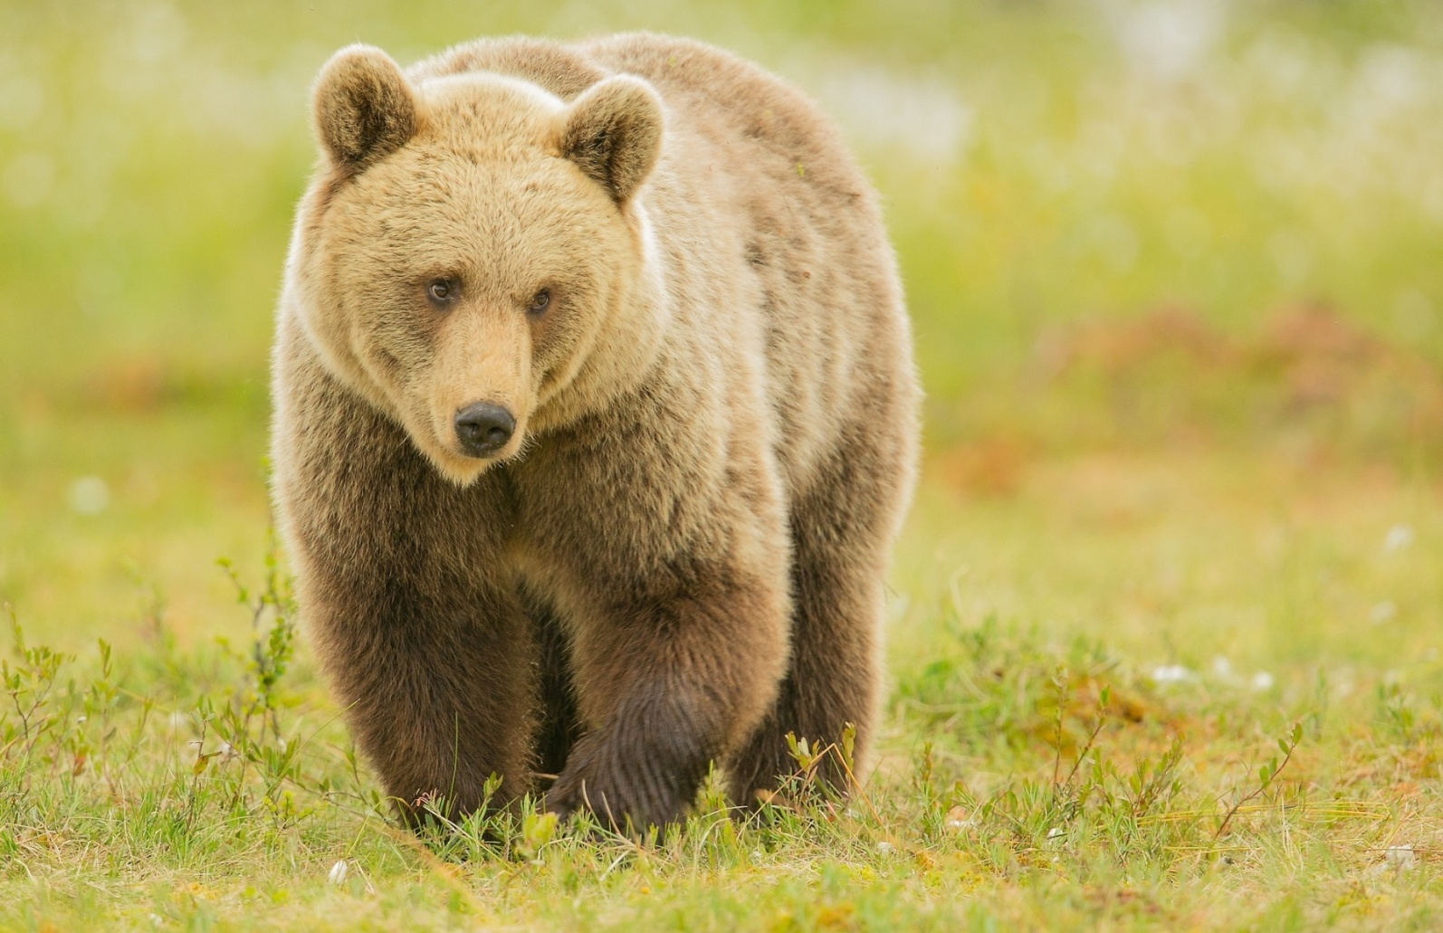
I live in the forest. I’ve got 4 legs and a short tail. I like to eat berries and fish. I’ve got a big body.

Slide 39
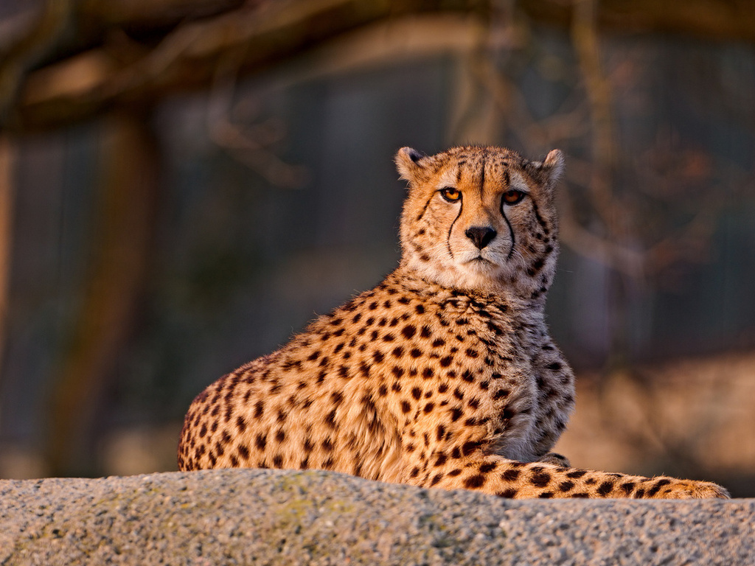
I live in the grassland. I eat meat. I am the fastest in the world. What am I ?

Slide 40
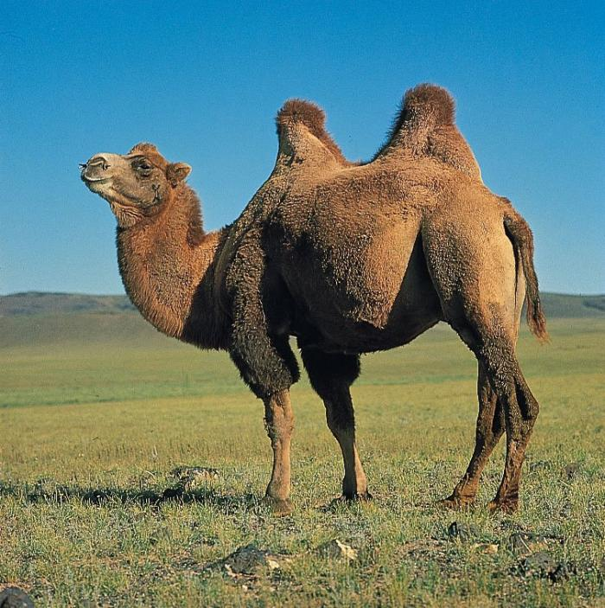
I live in the desert. I’ve got a long neck and 4 thin legs. I can live without water.

Slide 41
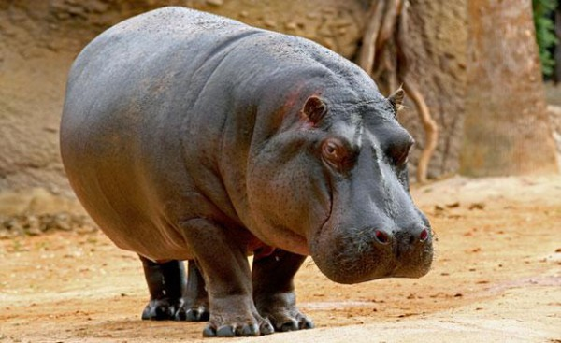
I live in the river. I am the fattest. I’ve got the biggest mouth in the world. What am I ?

